Slide 1


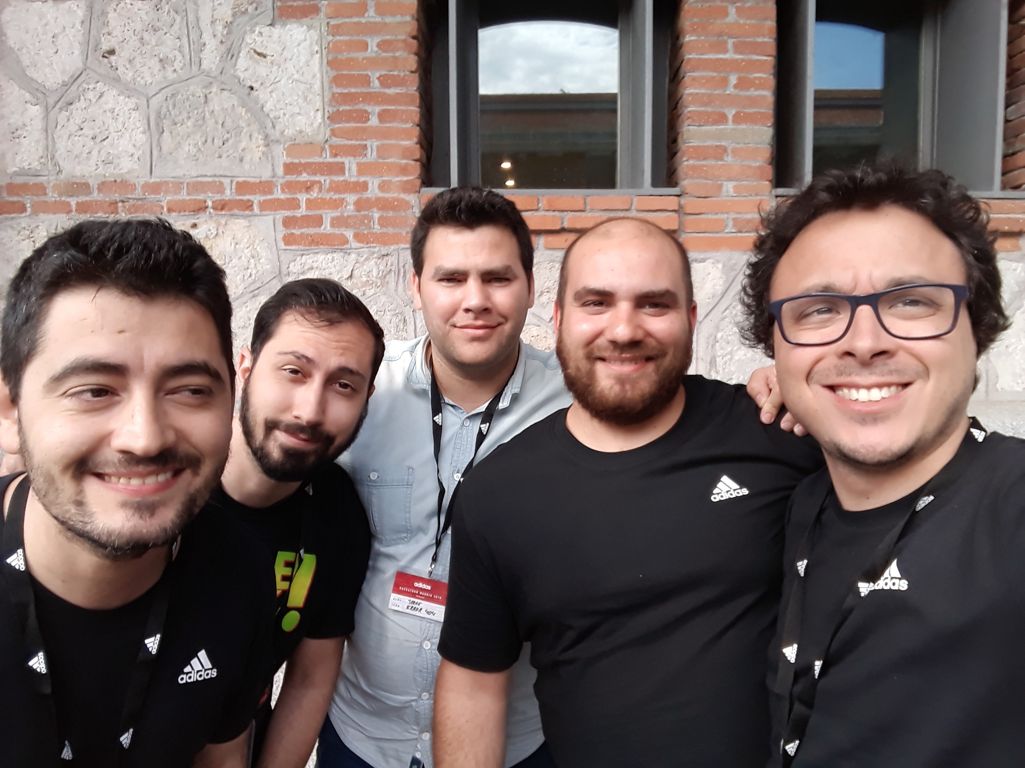


ERROR404
This is us!
Mariano Moreno
Jorge Rivero
Adriano Elorza
Fernando Ortega
Rolando González
IoT with Machine Learning
Machine Learning
TECHNOLOGIES
Big Data
IoT

